Slide 1
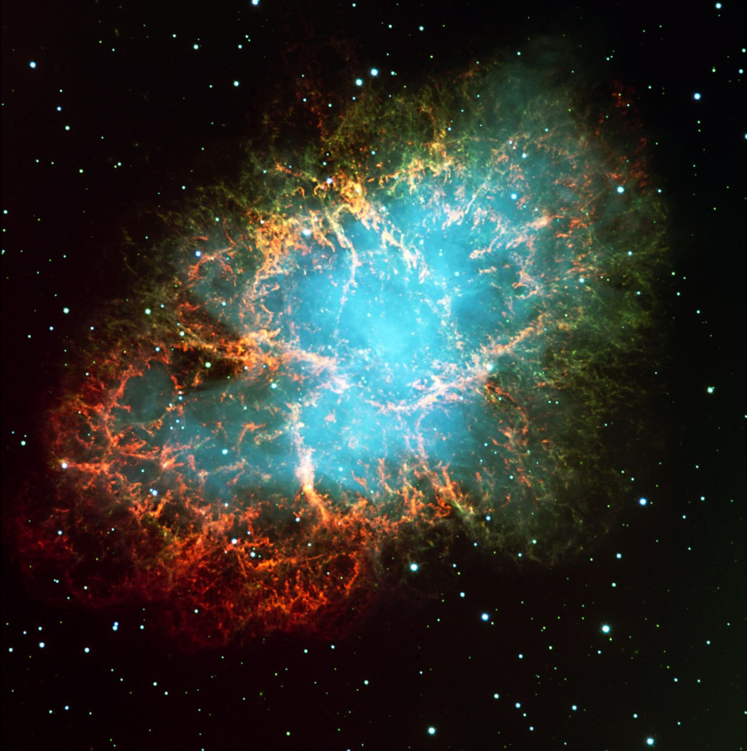
Preliminary results of giant pulse investigations from Crab pulsar with Radioastron.
Crab Nebula in optics. ESO, 1999.
Rudnitskiy A.G., Popov M.V., Soglasnov V.A.
Astro Space Center, Lebedev Physical Institute, Russian Academy Of Sciences, (ASC LPI RAS)
12th EVN SYMPOSIUM
Cagliari, Italy, 7-10 October 2014
E-mail: arud@asc.rssi.ru

Slide 2
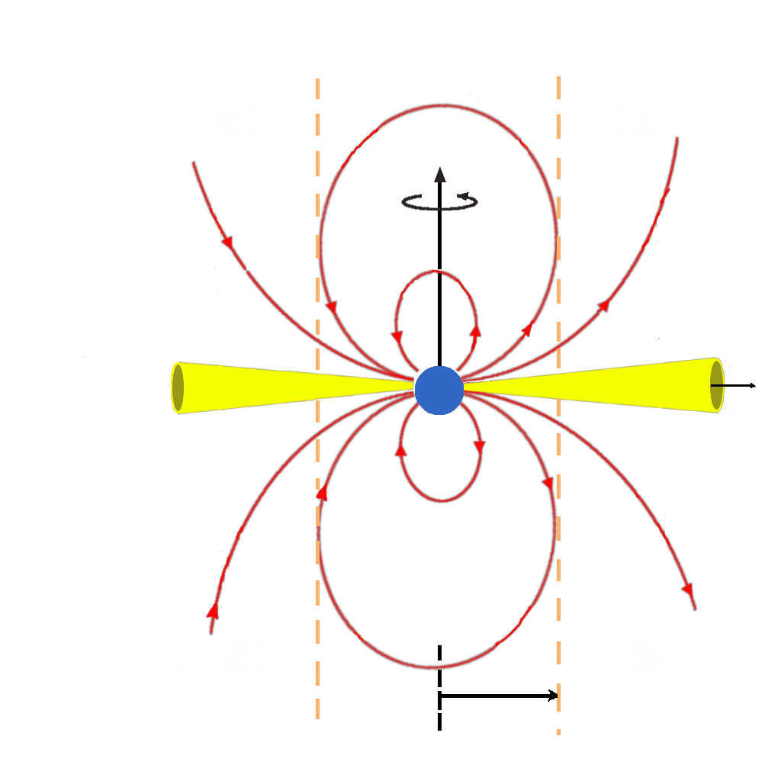
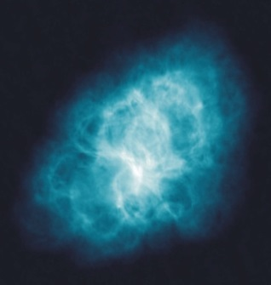
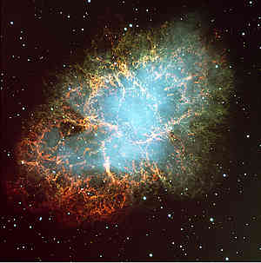
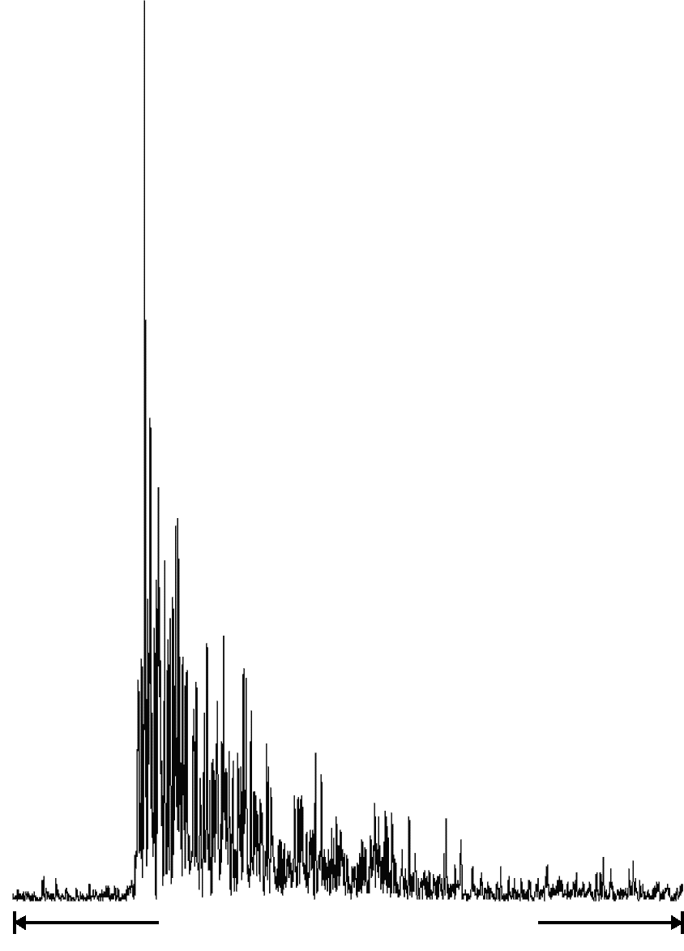
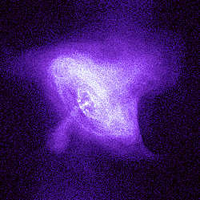
Neutron star (pulsar) in the Crab Nebular
After supernova explosion in 1054
Strong giant pulse at 408 MHz
Observed on 9th of May, 2000
(Medicina Northern Cross)
Sp=0.5 MJy
dt=0.2 ms
February 21 2007
20-th anniversary of SN1987A

Slide 3
Introduction Observations
Processed all sessions:
RAFS01, 14.11.2011, 4xED, 23:00 – 00:00, 18cm
Stations: RA, EV, BD, SV, ZC
28 pulses detected (SNR > 8.0)
Found correlation with RA for 1 pulse (23:21:03.74)
RAES04A, 02.03.2012, 11xED, 13:00 – 17:00, 18cm (EVN CODE: EG060A)
Stations: RA, EF, JB, ON, SV, BD, UR, HH, WB
424 pulses detected (SNR > 8.0)
No correlation with RA, issues in CCF and spectrum structure.
RAES04B, 06.03.2012, 10xED, 14:30 – 17:30, 18cm (EVN CODE: EG060B)
Stations: RA, EF, JB, ON, SV, BD, UR, HH, WB
356 pulses detected (SNR > 8.0)
Found correlation with RA for 8 pulses (strongest: 16:07:08.27)
RAES04D, 23.10.2012, 9xED, 07:00 – 09:00, 18cm (EVN CODE: EG067B)
Stations: RA, JB, WB, EF, NT, TR, AR, RO
362 pulses detected (SNR > 8.0)
Found correlation with RA for 10 pulses (strongest: 16:07:08.27)
RAKS02AD, 06.03.2012, 12xED, 14:30 – 17:30, 18cm (EVN CODE: EG075)
Stations: RA, EF, WB, NT, SV
149 pulses detected (SNR > 8.0)
Found correlation with RA for 9 pulses (strongest: 16:07:08.27)
RAKS02AE, 02.11.2013, 3-5xED, 19:30 – 1/08:40, 92cm (EVN CODE: GS033A)
Stations: RA, KL, WB, EF, JB, AR
172 pulses detected (SNR > 8.0)
No correlation with RA

Slide 4
Introduction Software
ASC Correlator
Additional giant pulse search mode was developed.
Amplitude normalization software.

Slide 5
Correlation procedure
Apply incoherent dedispersion for each data window (same approach as in ASC Correlator for regular pulsars).
For each data “window” obtain CCF.
Check the peak maximum value to mean noise with criteria from input file for each data window.
Write down data for all baselines if GP was found.
NO GP
CRITERION CHECK FOUND GP

Slide 6
Scattering disk size
Visibility vs. baseline approximation:
To estimate the angular size of the scattering disk using visibility vs. baseline relation
θ_{H} - FWHM angular diameter, B – baseline projection in wavelengths, λ - observation wavelength
(Gwinn, Bartel & Cordes, 1993)
Scattering time:
To estimate the angular size of the scattering disk using scattering time
L = 2 kpc – distance to pulsar, α – distance to the scattering screen related to L, τ - scattering time, c – speed of light
(Britton, Gwinn & Ojeda, 1998)
Diffraction radius can be estimated using the following relation:
$$V\left(B\right)=V_{0}e^{\left[−\frac{1}{2}∙{\left(\frac{π}{\sqrt{2\ln{2}}}∙\frac{θ_{H}∙B}{λ}\right)}^{2}\right]}$$
$${θ_{τ}^{}}_{}^{2}=\frac{8cτ∙\ln{2}∙(1−α)}{αL}$$
$$R_{diff}=/$$

Slide 7
Scattering disk size Amplitude normalization
$$A_{norm}=\frac{A}{R}$$
For ground-ground baselines:
$$R=\sqrt{({σ_{1tot}}_{}^{2}−{σ_{1off}}_{}^{2})⋅({σ_{2tot}}_{}^{2}−{σ_{2off}}_{}^{2})}$$
Where “1” and “2” – ground telescopes
For space-ground baselines:
$$R=({σ_{2tot}}_{}^{2}−{σ_{2off}}_{}^{2})⋅\frac{σ_{1off}}{σ_{2off}}⋅\sqrt{\frac{{SEFD}_{2}}{{SEFD}_{1}}}$$
Where “1” is space radio telescope, “2” is ground telescope

Slide 8
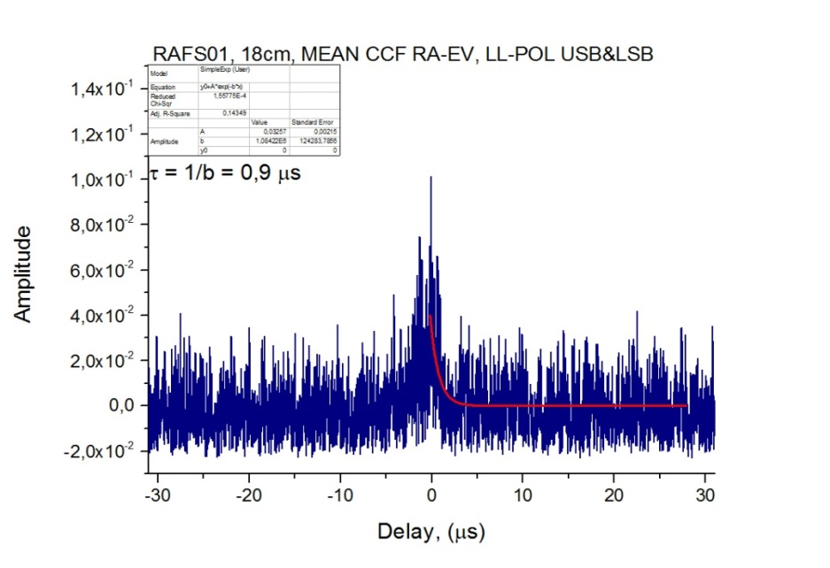
Scattering time
Obtain mean cross-correlation function for space-ground baseline
Use exponential approximation to estimate scattering time
Scattering time and decorrelation band connected with a relation:
$$A={C+A}_{0}e^{−\frac{b}{x}}$$
$$τ=1/b$$
$$2π∙Δν∙τ=1$$
Scattering time estimation for mean CCF.

Slide 9
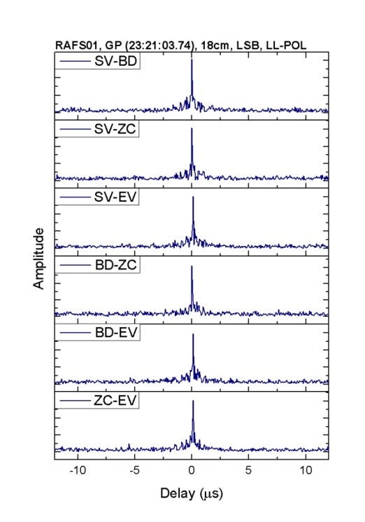
Cross-correlation function shape
Cross-correlation function shapes for space-ground and ground-ground baselines.

Slide 10
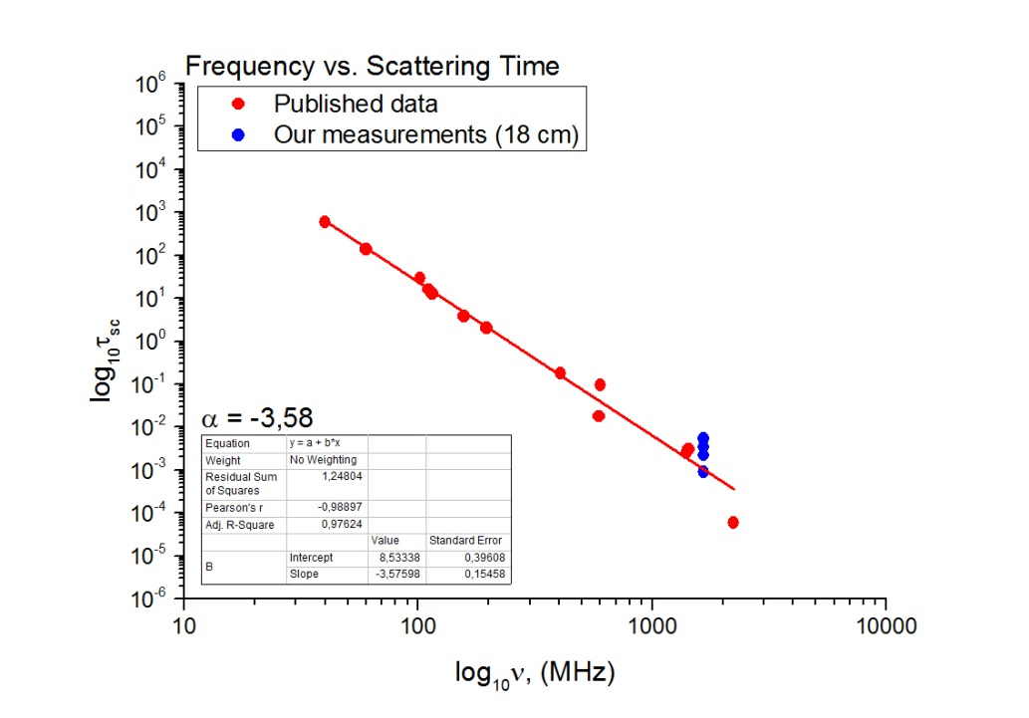
Angular size of scattering disk, Scattering time
Comparison of scattering disk angular size for different frequencies.
Comparison of scattering time for different frequencies.

Slide 11
Distance to the scattering screen
$$α=\frac{8cτ∙\ln{2}}{θ_{}^{2}L+8cτ∙\ln{2}}$$
18 cm:
RAFS01 1,318 [mas], 0,9 us α = 0,36
(d = D/3, Desai, Gwinn et al., 1992)
RAES04A 0,618 [mas], 5,8 us α = 0,94
RAES04B 0,501 [mas], 5,5 us α = 0,96
RAES04D 1,182 [mas], 5,1 us α = 0,79
RAKS02AD 1,235 [mas], 2,2 us α = 0,61

Slide 12
Summary for 18 cm observations
Transition point
Visibility amplitude vs. Baseline projection.
All strongest pulses for all 18 cm sessions together.

Slide 13
Summary for 92 cm observations
Visibility amplitude vs. Baseline projection.
All strongest GPs.

Slide 14
Conclusions
Processed all the observations within Radioastron mission. In four of six sessions successfully found correlation for space-ground baselines.
Observed significant change in CCF shape for space-ground baselines.
Distribution of visibility from baseline projection coincides with the theory of Goodman and Narayan.
At 92 cm scattering disk is being resolved on ground-ground baselines.
Estimated distance to the scattering screen shows the possibility to use multiple screen theory.

Slide 15
Thank you for your attention!

Slide 16
List of estimated parameters
Scattering disk size
Diffraction radius
Decorrelation band
Scattering time

Slide 17
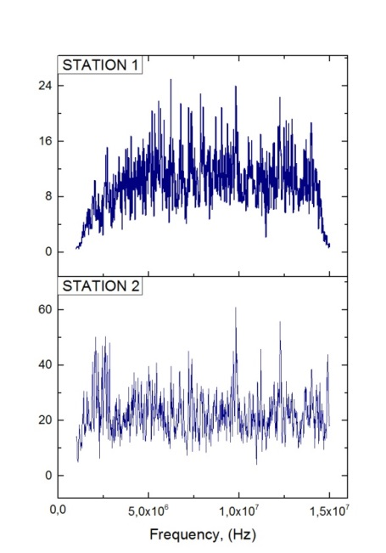
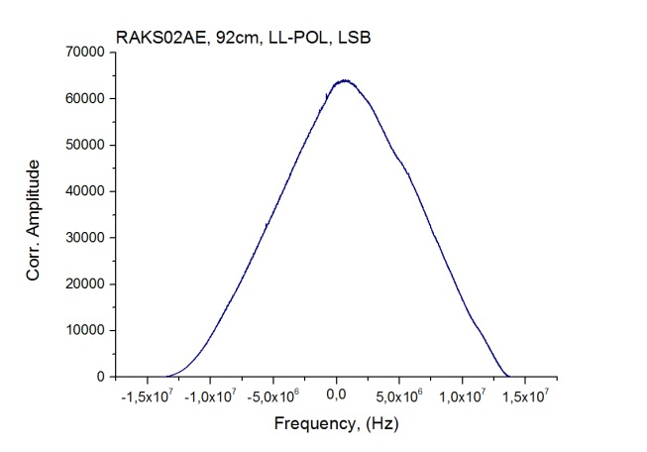
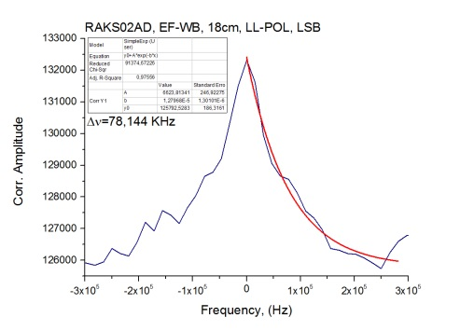
Decorrelation band
Obtain mean auto spectra for two strongest stations
Correlate two auto spectrum
Cut the region with the cross-correlation peak
Estimate decorrelation band using exponential approximation:
$$A={C+A}_{0}e^{\left[−\frac{1}{∆ν⋅x}\right]}$$

Slide 18
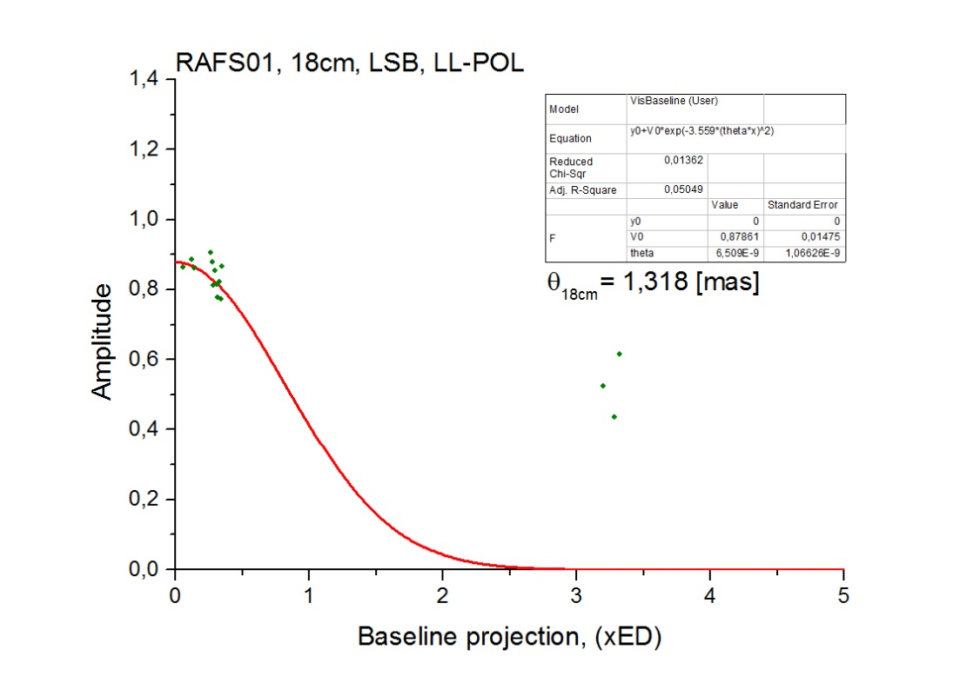
Preliminary results – RAFS01
CCFs for the strongest GP (23:21:03.74).
Left picture – space-ground baselines only, right picture – ground baselines only.
Visibility amplitude vs. Baseline projection.
All strongest GPs.

Slide 19
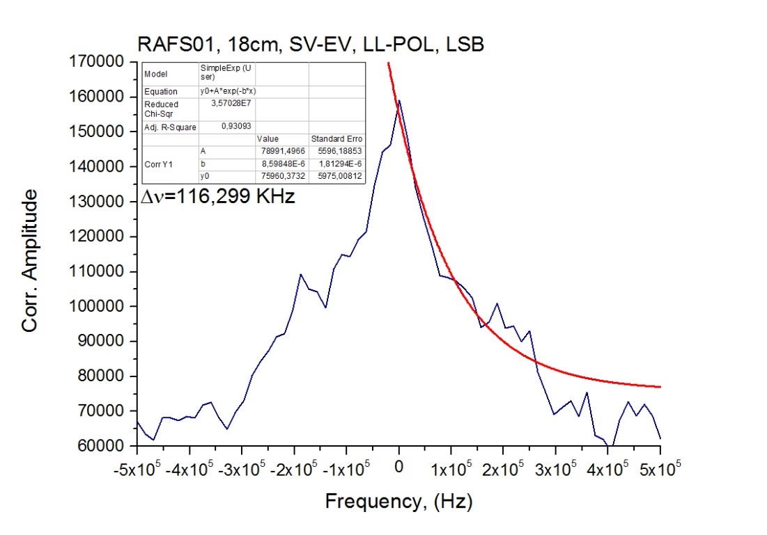
Preliminary results – RAFS01
Scattering time estimation
for mean CCF.
Decorrelation band estimation.

Slide 20
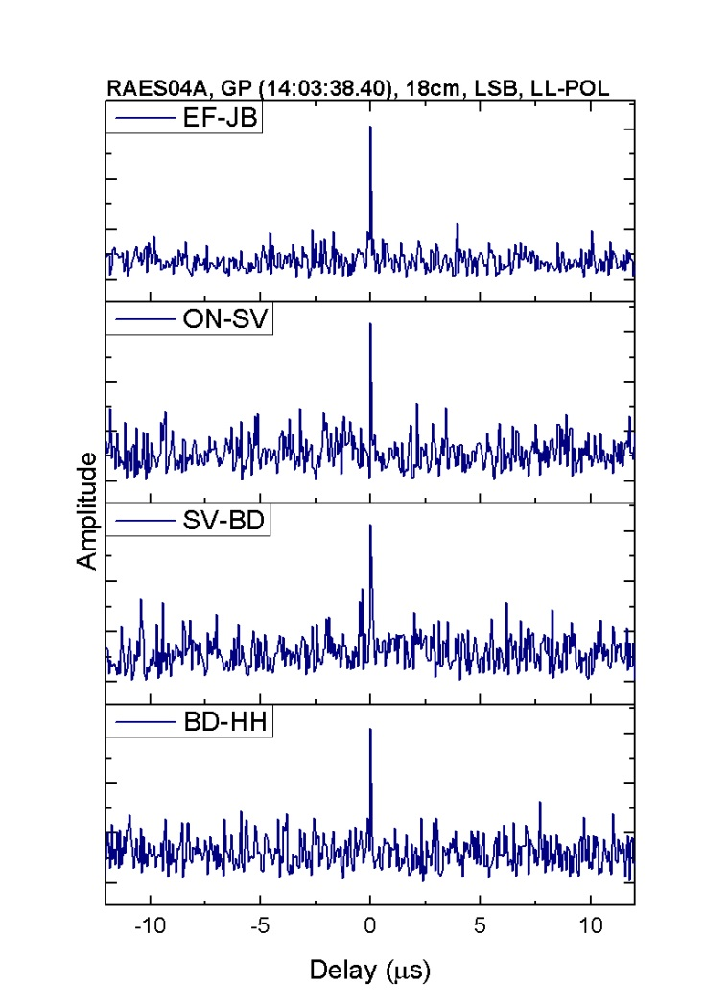
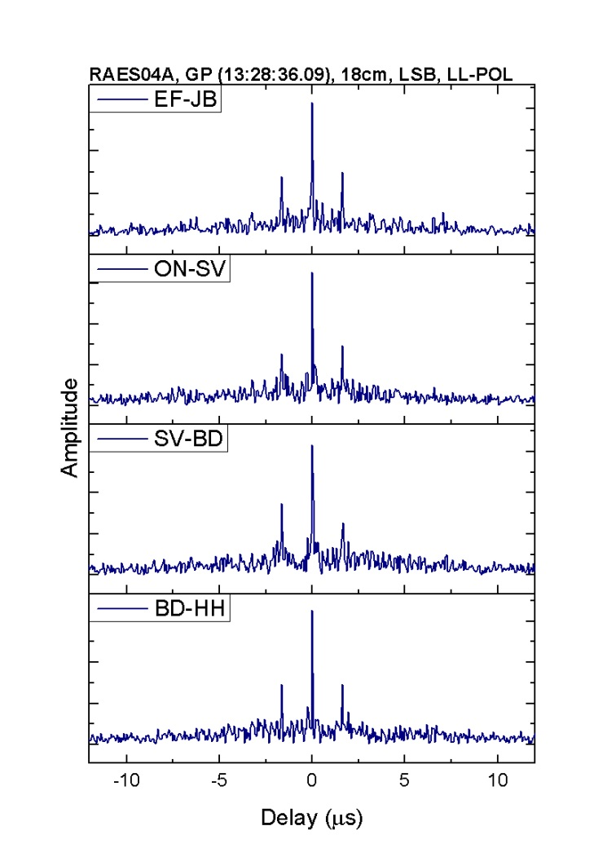
Preliminary results – RAES04A
CCFs and auto spectrum for the strongest pulse (right) and for the medium amplitude detected pulse (left).

Slide 21
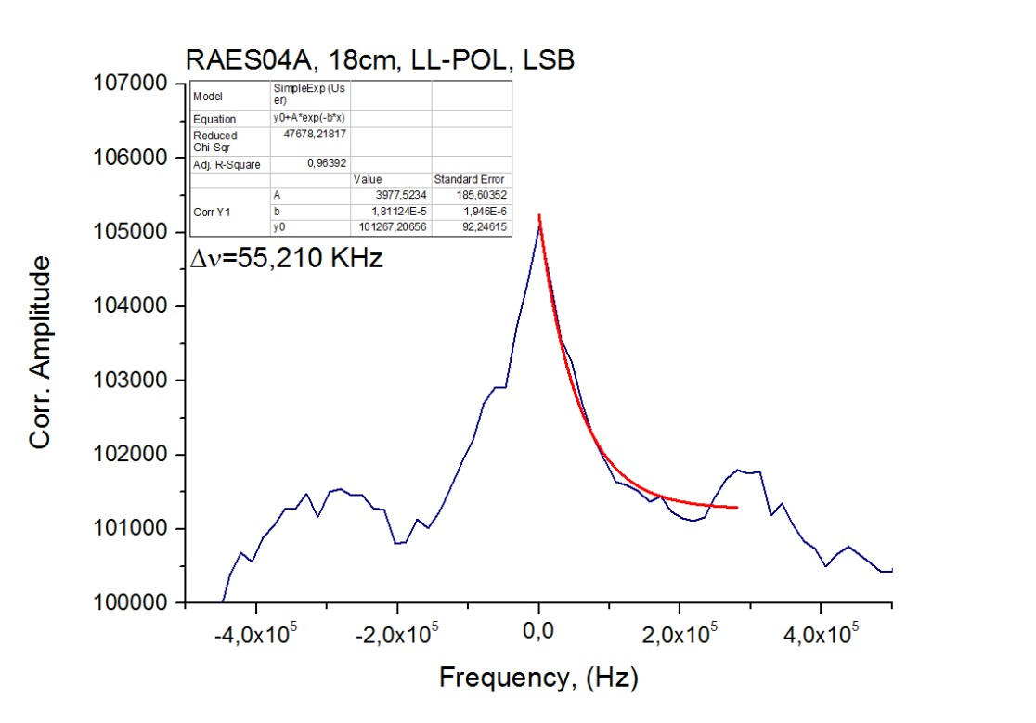
Preliminary results – RAES04A
Visibility amplitude vs. Baseline projection.
All strongest GPs.
Decorrelation band estimation.

Slide 22
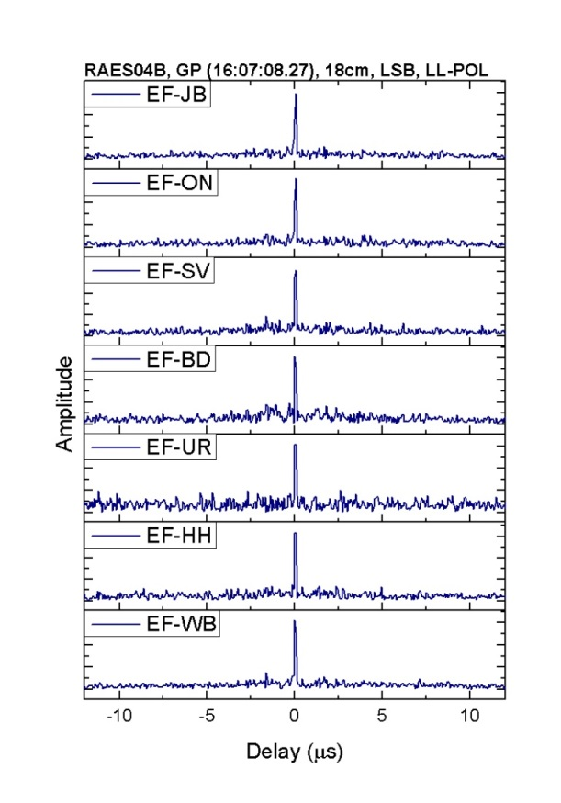
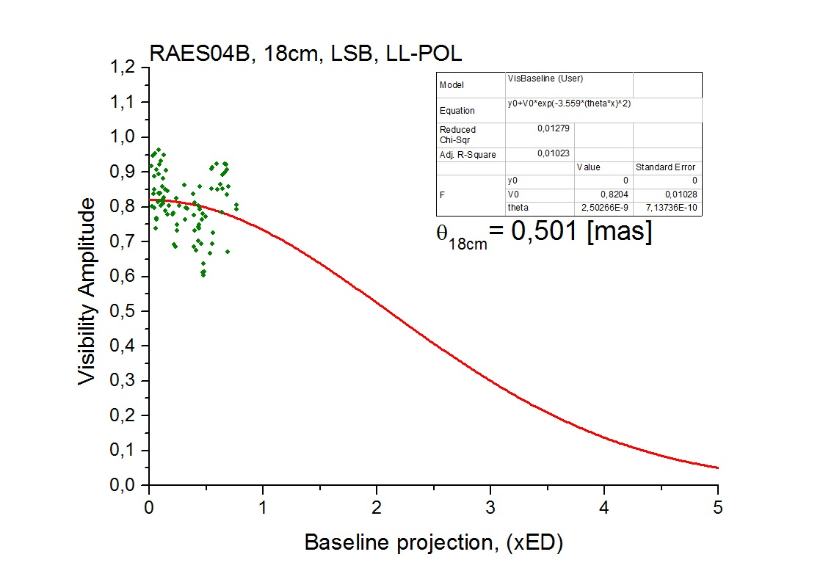
Preliminary results – RAES04B
CCFs for the strongest GP (16:07:08.27).
Left picture – space-ground baselines only, right picture – ground baselines only.
Visibility amplitude vs. Baseline projection.
All strongest GPs.

Slide 23
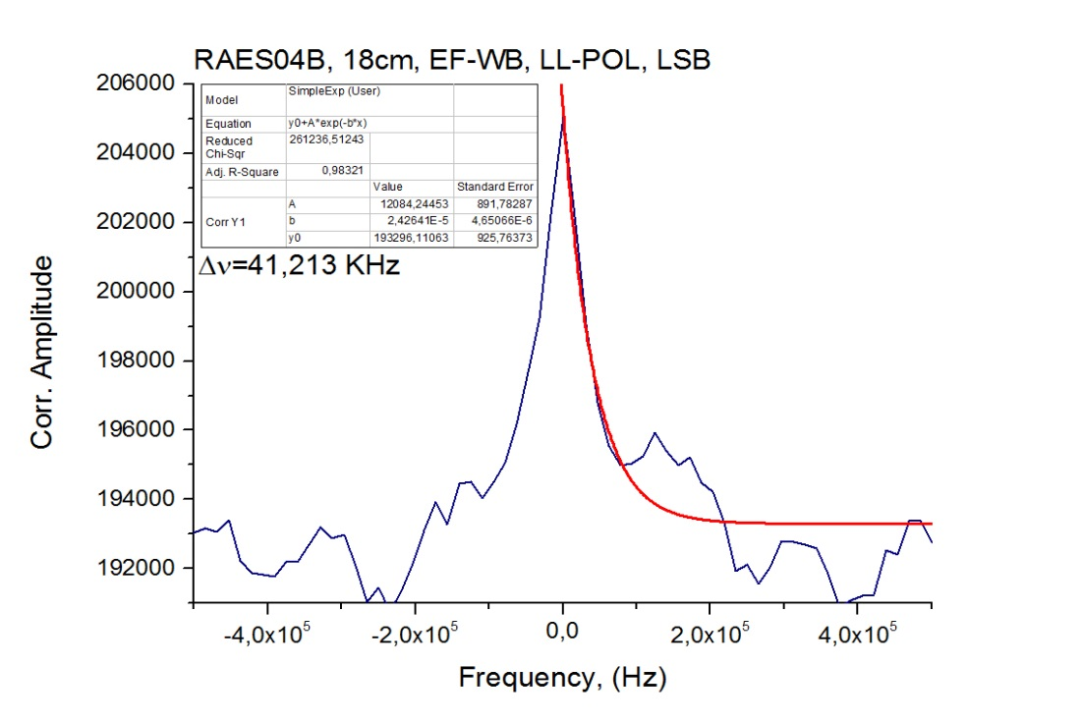
Preliminary results – RAES04B
Scattering time estimation for mean CCF.
Decorrelation band estimation.

Slide 24
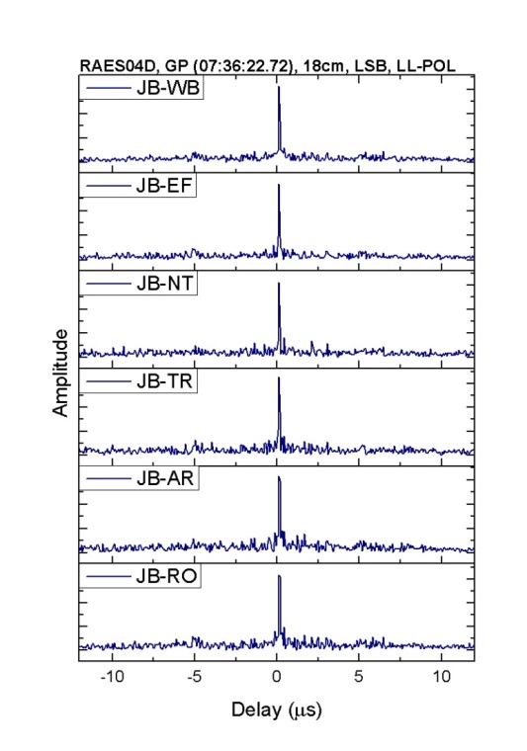
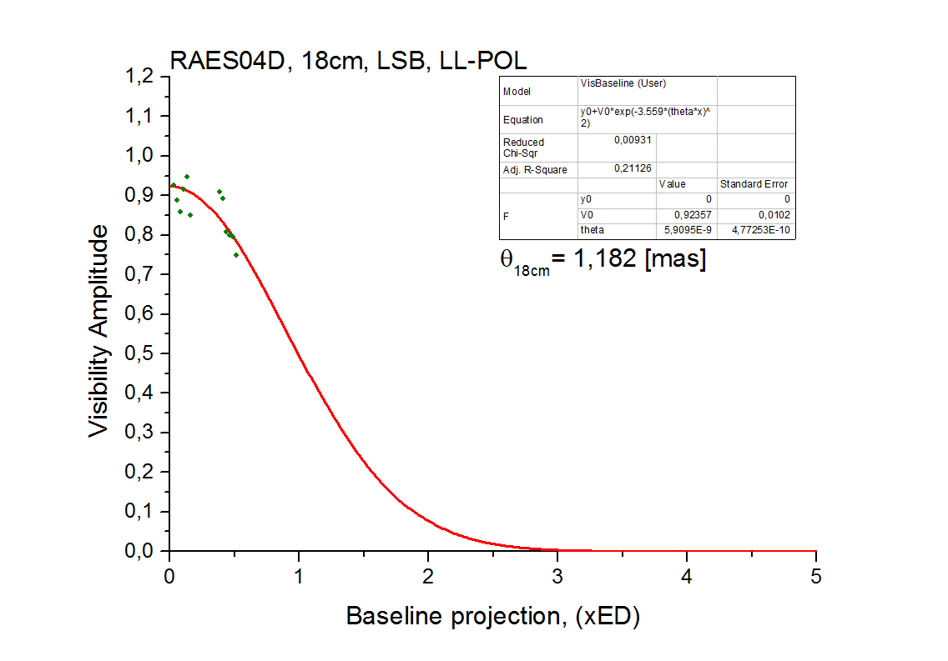
Preliminary results – RAES04D
CCFs for the strongest GP (07:36:22.72).
Left picture – space-ground baselines only, right picture – ground baselines only.
Visibility amplitude vs. Baseline projection.
All strongest GPs.

Slide 25
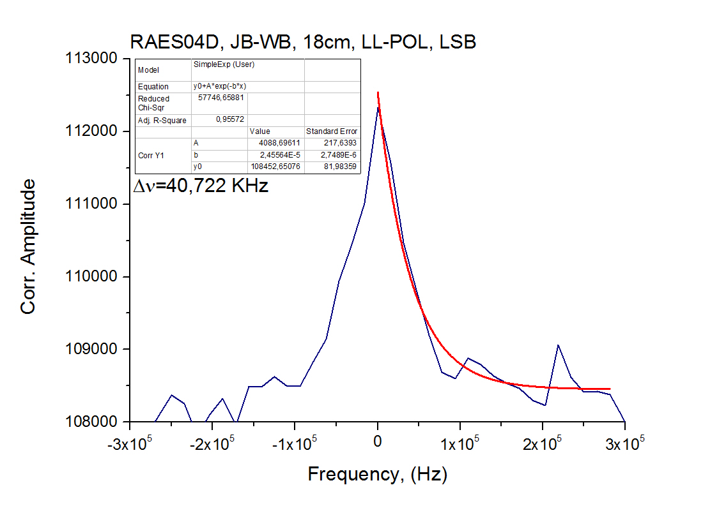
Preliminary results – RAES04D
Scattering time estimation for mean CCF.
Decorrelation band estimation.

Slide 26
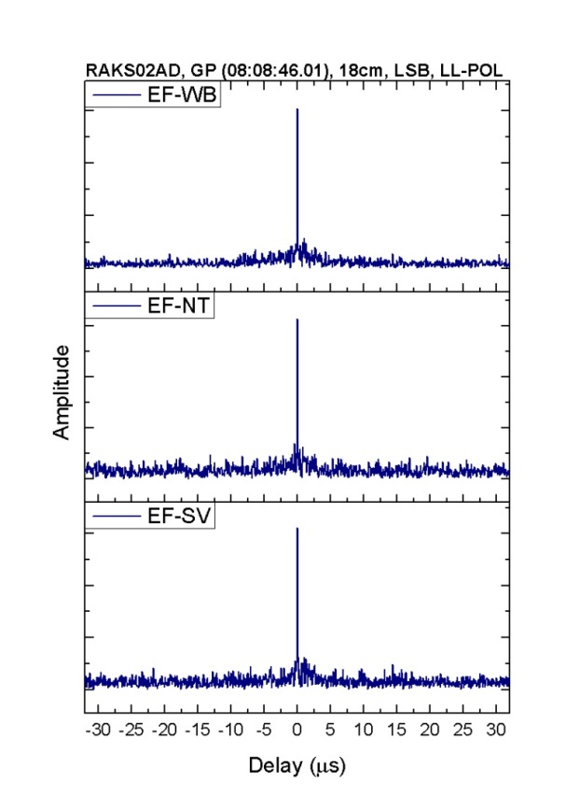
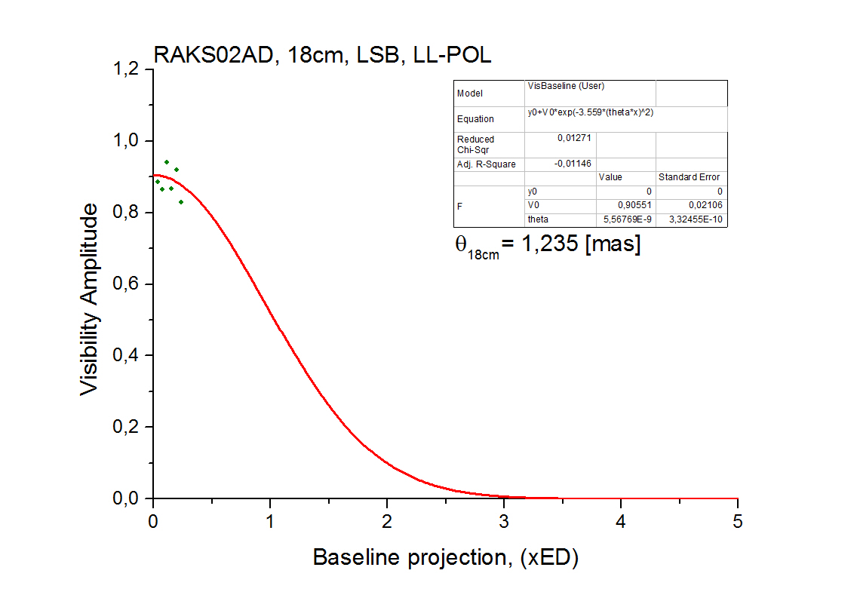
Preliminary results – RAKS02AD
CCFs for the strongest GP (08:08:46.01).
Left picture – space-ground baselines only, right picture – ground baselines only.
Visibility amplitude vs. Baseline projection.
All strongest GPs.

Slide 27
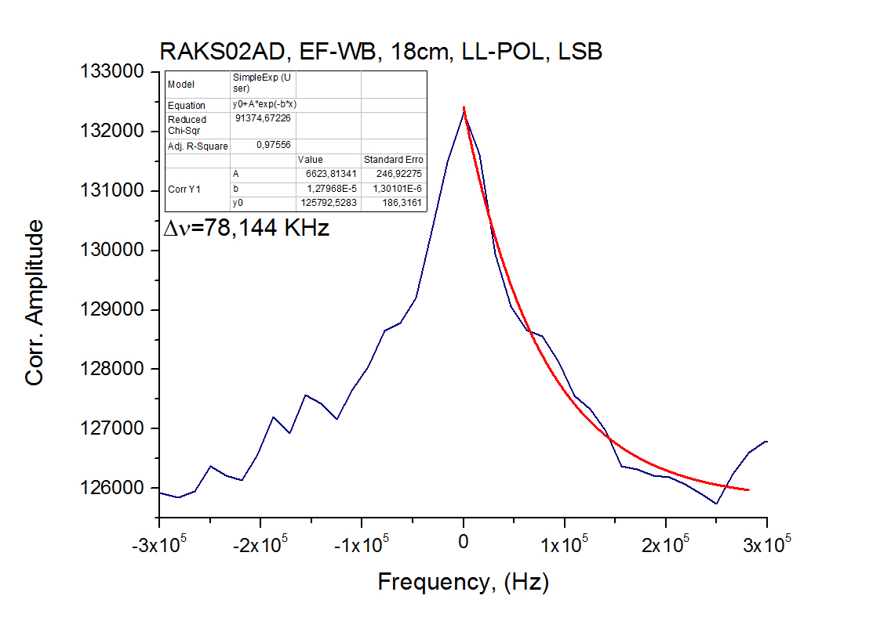
Preliminary results – RAKS02AD
Scattering time estimation for mean CCF.
Decorrelation band estimation.

Slide 28
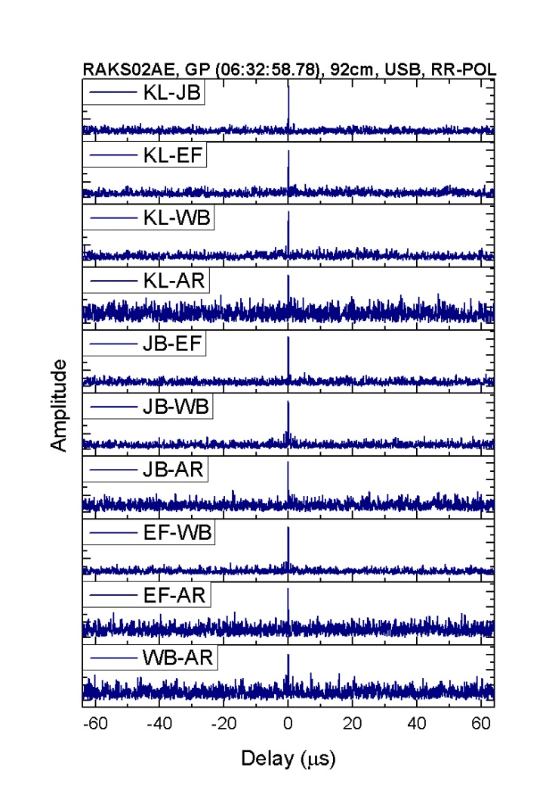
Preliminary results – RAKS02AE
CCFs for the strongest GP (06:32:58.78).
Left picture – space-ground baselines only, right picture – ground baselines only.

Slide 29
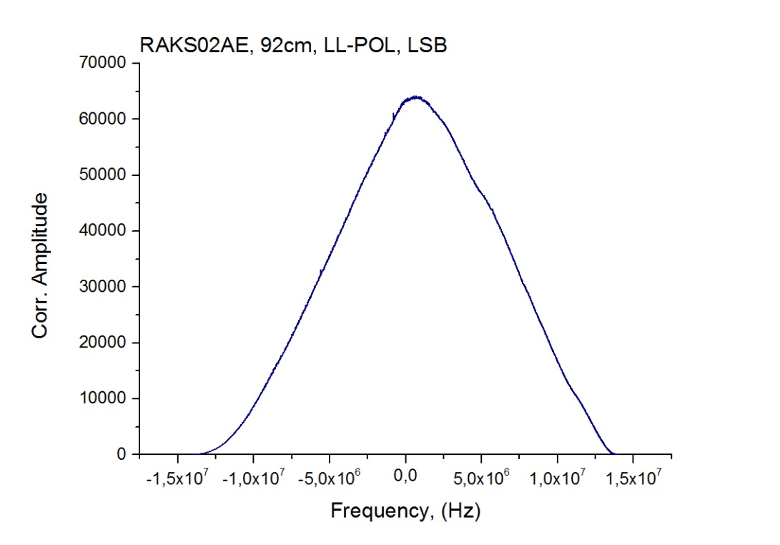
Preliminary results – RAKS02AE
Visibility amplitude vs. Baseline projection.
All strongest GPs.
Decorrelation band estimation.
No visible peak for 92 cm!

Slide 30
Angular size of scattering disk & Diffraction radius
18cm:
RAFS01 1,318 [mas] 27314 km
RAES04A 0,618 [mas] 58252 km
RAES04B 0,501 [mas] 71856 km
RAES04D 1,182 [mas] 30456 km
RAKS02AD 1,235 [mas] 29149 km
92cm:
RAKS02AE 14,013 [mas] 13130 km

Slide 31
Scattering time & Decorrelation Band
$$2π∙Δν∙τ=1$$
18 cm:
RAFS01 0,9 us 116,299 KHz 1,05
RAES04A 5,8 us 55,210 KHz 2,00
RAES04B 5,5 us 41,213 KHz 2,27
RAES04D 5,1 us 40,722 KHz 2,08
RAKS02AD 2,2 us 78,144 KHz 1,72

Slide 32
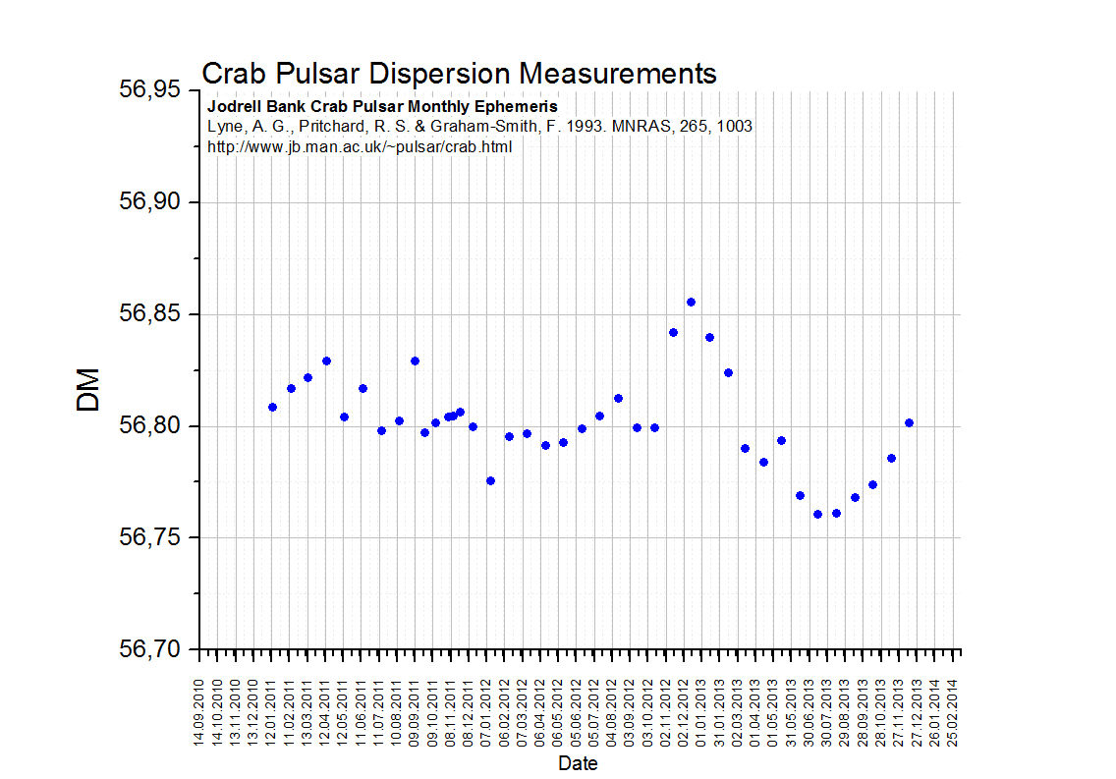
Dispersion measurements
RAFS01
RAES04D
RAES04(A,B)
RAKS02(AD,AE)
Monthly dispersion monitoring by Jodrell Bank.
Data from Jan, 2011 to Dec, 2013.

